Slide 1
Analyzing Medical Questions
Peter Tadrous
CUS 635
Web Data Mining
Spring 2021

Slide 2

Introduction
Collect medical questions
Extracted and clean the data
Tokenize the data
Cluster the data
Extract meaningful insights
Notes:
I used a medical questions dataset from Github and extracted just the medical questions and a few other useful fields
I then used pandas to analyze the data and clean it up
Then I tokenized with NLTK to create a tf-idf matrix and reduced the features with TSNE.

Slide 3



First Step: Collect the data
Medical Question-and-Answer Pairs on GitHub
47,457 medical question-answer pairs created from 12 NIH websites (e.g. cancer.gov, niddk.nih.gov, GARD, MedlinePlus Health Topics)
Notes:
Very large dataset in XML format.
Lots of information such as source and url of the answer, focus, category, and question type, as well as synonyms.
We only need what’s useful within our scope.

Slide 4
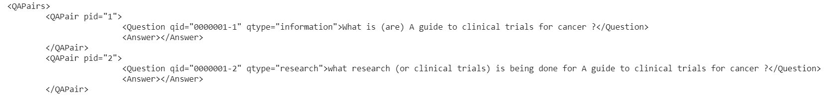
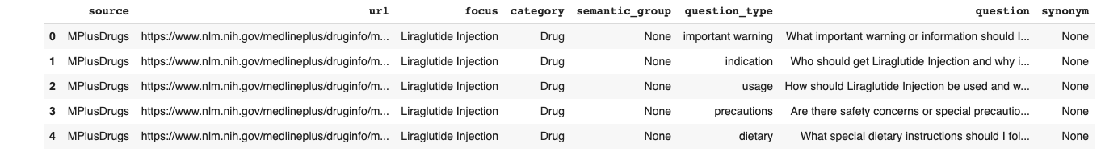
Formatting The Data
Notes:
As the raw data is in XML format, we parsed the data. After looking through the data, we created some functions to extract the questions.

Slide 5
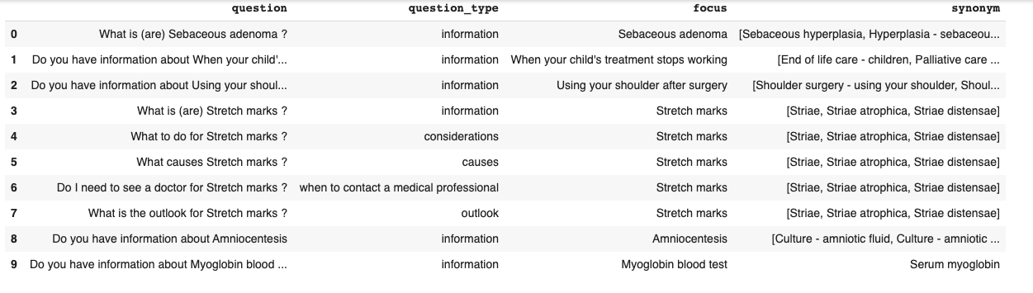
Data Cleaning Methods
Removed fields that aren’t useful
Removed rows of null data
Notes:
.describe() to see counts, # of unique, top and freq
(by compare counts and # of unique)clean up duplicate questions
remove “category” and “semantic group”

Slide 6
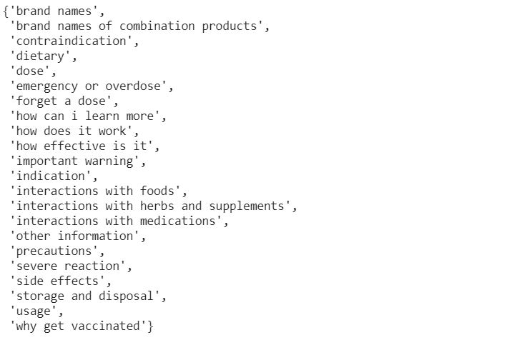
Decisions Made in Cleanup
Trade-off between diversity of data and completeness of data.
Original, inconsistent dataset:
47,441 records
Cleaned and consistent dataset:
23,319 records
Question types no longer in the data.
Notes:
Now we have 23,319 questions for analysis. Even though this is roughly half the size of the original dataset, we think this amount of data is sufficient for our analysis. However, given that the focus and synonym columns were derived from something that appears in the original dataset per file and not per question, we have less diversity in the cleaned dataset. This is obvious from the question_type going from 39 unique values to 17 unique values.

Slide 7
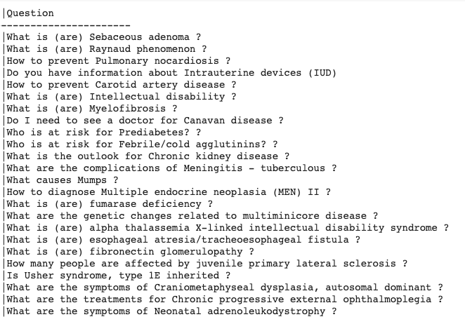
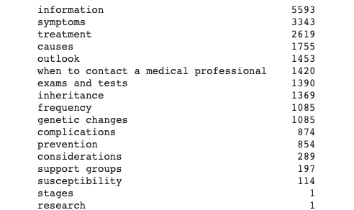
Questions Remaining
Subset of the 23,319 questions.
Question types and counts after cleaning the data.
Notes:
We still think that with this cleaned dataset, we have sufficient diversity in the types of questions for our analysis.

Slide 8
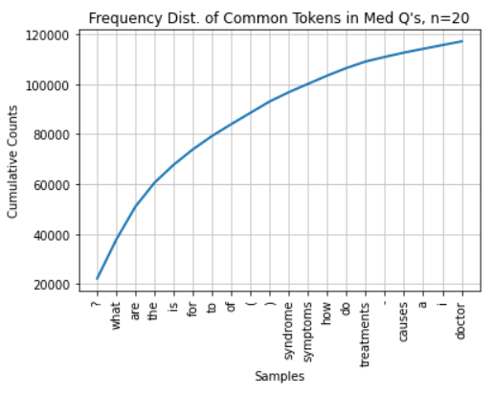
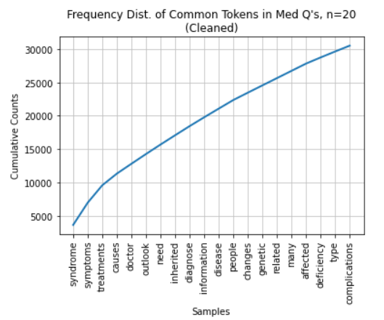
Tokenizing and further Cleaning with NLTK
Notes:
Tokenize full dataset, along with separate tokenization by question type. Then clean:
punctuation removed
stop words removed
small word removed(less than 3 characters)
We remove all these for future analysis

Slide 9
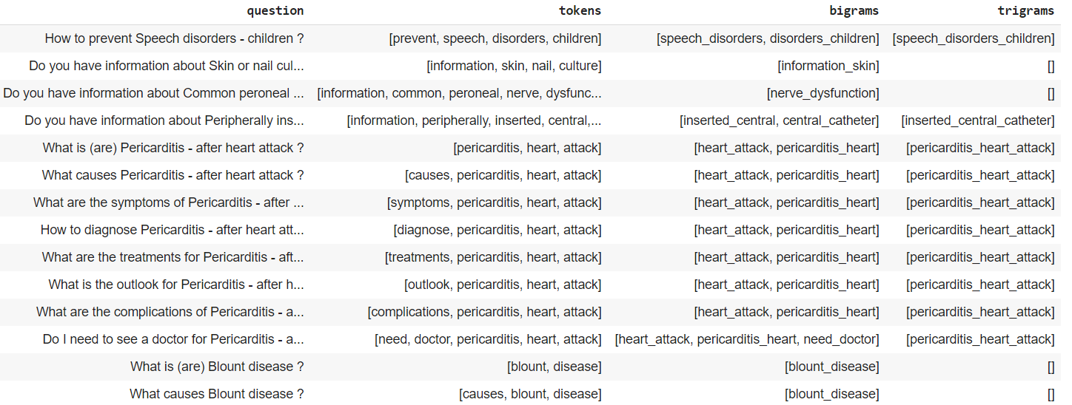
Multi-Word Tokens
Notes:
Analyzing collocation of tokens to generate n-grams.

Slide 10
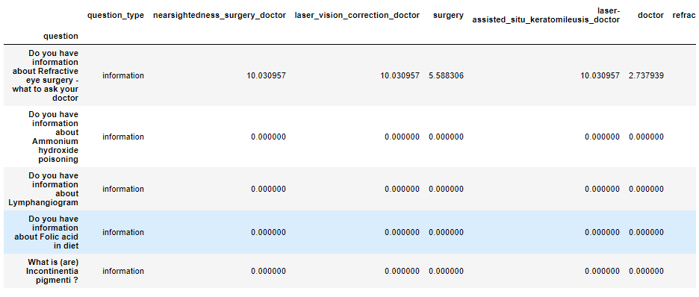
TF-IDF

Slide 11
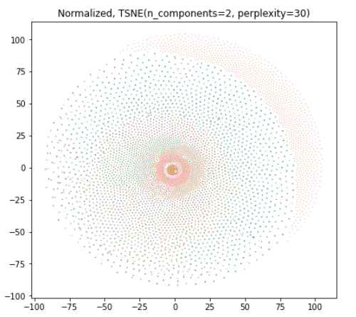
Feature Reduction

Slide 12
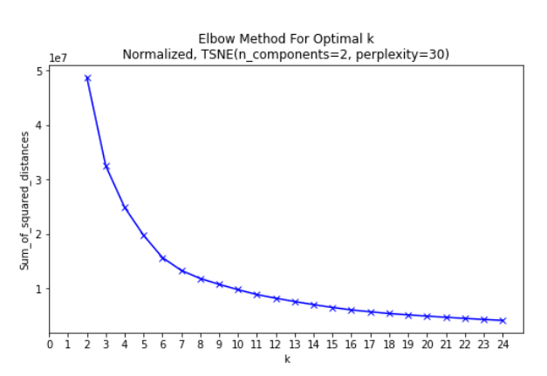
Clustering: Using KMeans

Slide 13
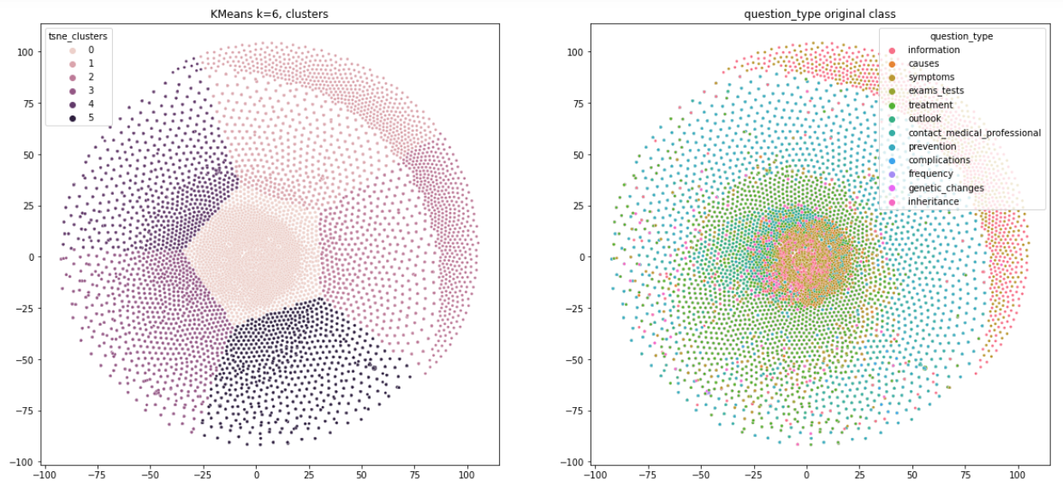
Clustering: Using KMeans

Slide 14
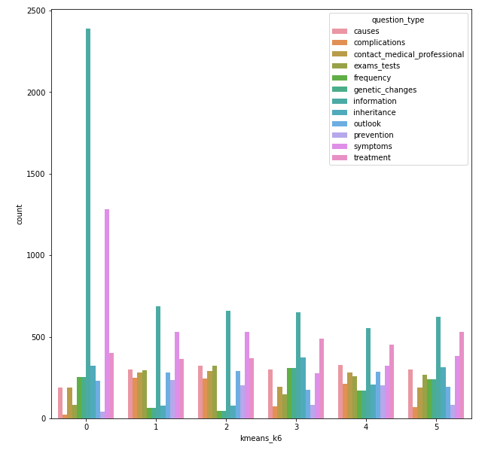
Distribution of Question Type by Cluster

Slide 15
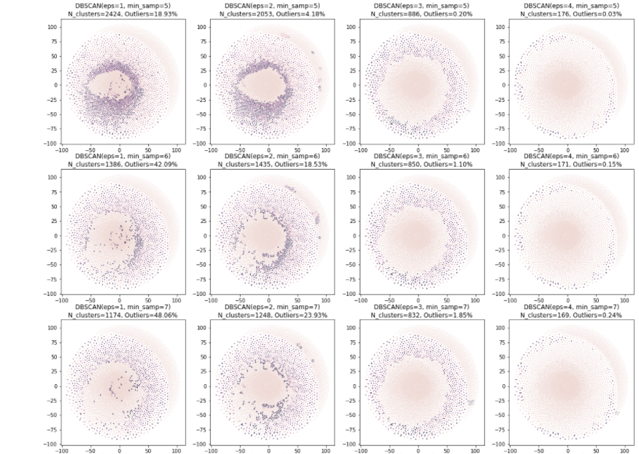
Clustering: Using DBSCAN

Slide 16
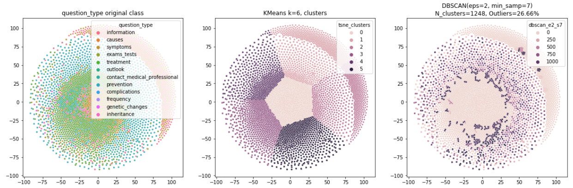
Comparing KMeans with DBSCAN

Slide 17
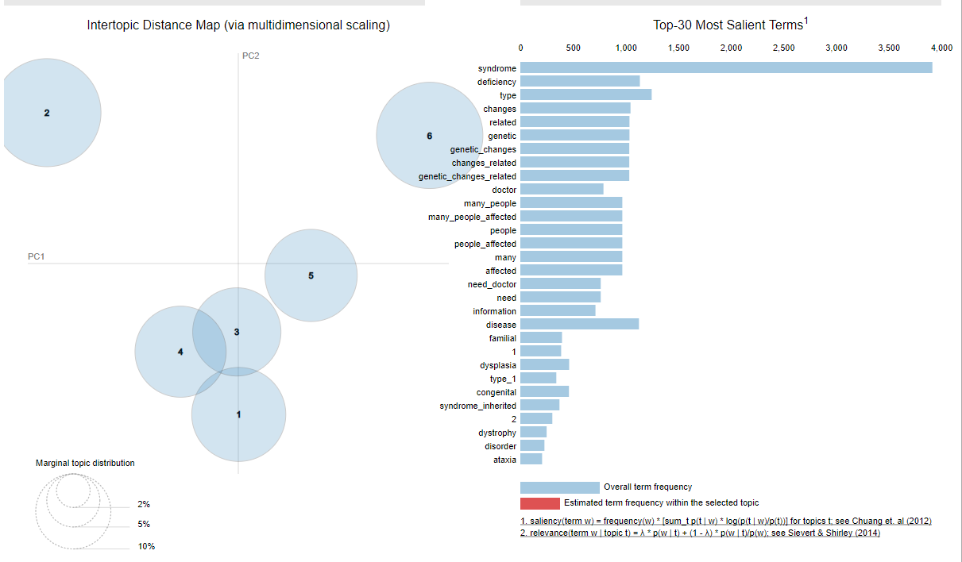
Topic Modeling: Using LDA

Slide 18
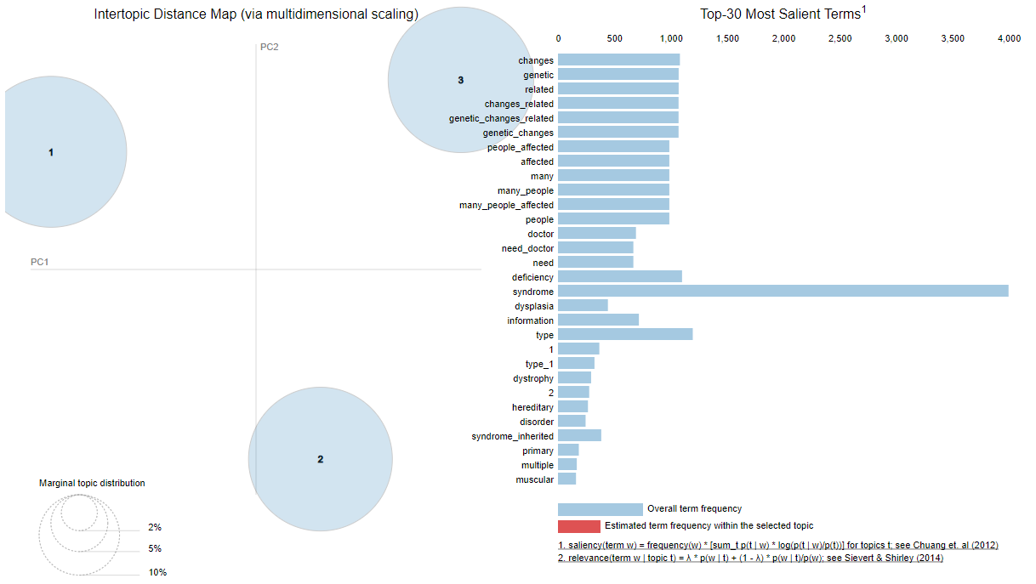
Topic Modeling: Using LDA

Slide 19
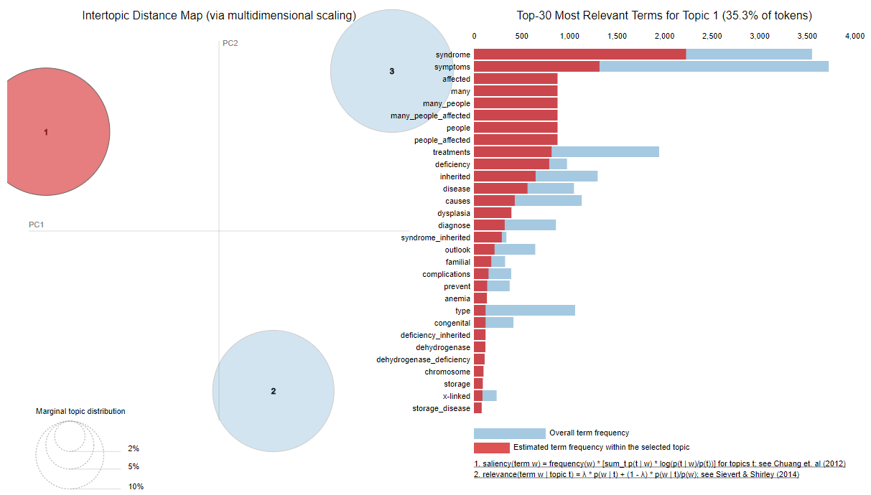
Topic 1 – Symptoms and Effects

Slide 20
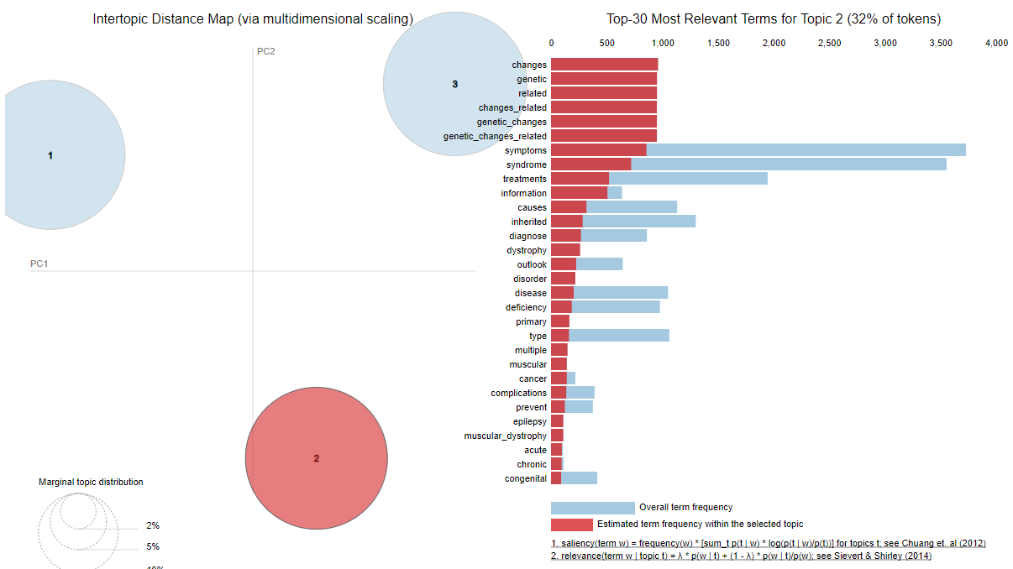
Topic 2 – Genetics

Slide 21
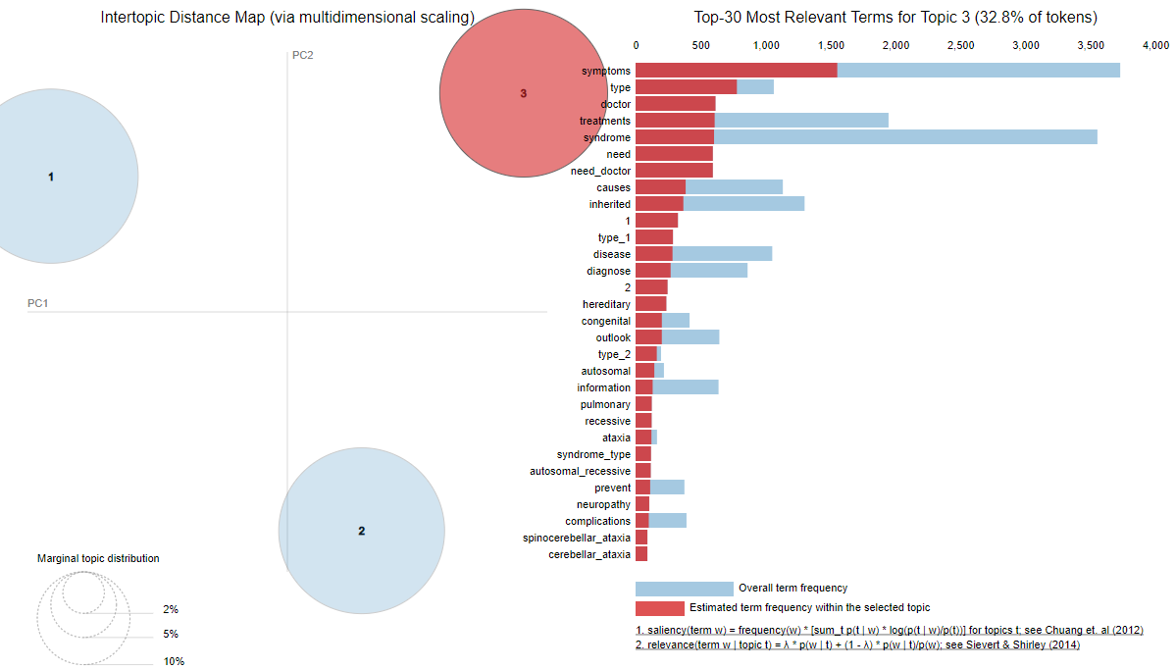
Topic 3 – Doctor Visits/Treatment

Slide 22
Future Research
I believe further analysis is needed for a better understanding of this data. Some things to keep in mind going forward:
It may be better to start off with a completely unsupervised approach using only the tokens found in the questions. This means excluding focus and synonyms.
Additionally, it might be beneficial to the analysis to use PCA before tSNE to eliminate noise and reduce the features to only those that explain the most variance. This way, when tSNE is used, it is only reducing the important features.
I suggest trying different n for dimensions when using tSNE, as I only tested it with 2 dimensions. This seemed to hinder the analysis as it is very difficult to reduce 30,000+ features to just 2.
The question_type field does not seem to have been derived in any meaningful way with regards to NLP. With completely unsupervised learning, we may be able to find a much better grouping of clusters and be able to accurately model the topics of each cluster.

Slide 23
References
Ben Abacha, A., Demner-Fushman, D. A question-entailment approach to question answering. BMC Bioinformatics 20, 511 (2019). https://doi.org/10.1186/s12859-019-3119-4
Medical Question-and-Answer Pairs on GitHub

